Slide 1
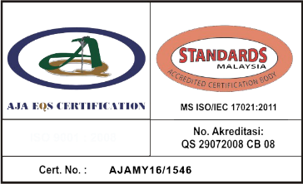
ULTRASONIC PEENING SOLUTIONS FIELD TRIAL REPORT

Slide 2
INTRODUCTION
MRA INTERNATIONAL SDN BHD were requested to conduct a field trial on the pipe spool using Ultrasonic Peening Solutions.
Field trial were divided into two types:
Introduction of external strain on pipe spool
Removal of external strain on pipe spool.
The field trial were conducted based on capability :
MMM Stress Measurement Technology
Ultrasonic Peening Technology

Slide 3
OBJECTIVES
The objectives of the field trial are:
To determine stress concentration zones (SCZs) area using MMM technology
To implement ultrasonic peening impact on the selected most critical SCZs findings
To determine the correlation between reduction of SCZs based on introduction of external strain and removal of external strain

Slide 4
METHODOLOGY
Stress Measurement
Ultrasonic Peening Technology
Report Preparation

Slide 5
IDENTIFICATION OF SCZs LOCATION
External strain due to bolting
Removal of external strain due to bolting

Slide 6
PERCENTAGE OF REDUCTION FOR MAXIMAL STRESS VALUE
Initial (%)
-External strain
-With coating
-External strain
-Without coating
-Removal external strain
-Without coating

Slide 7
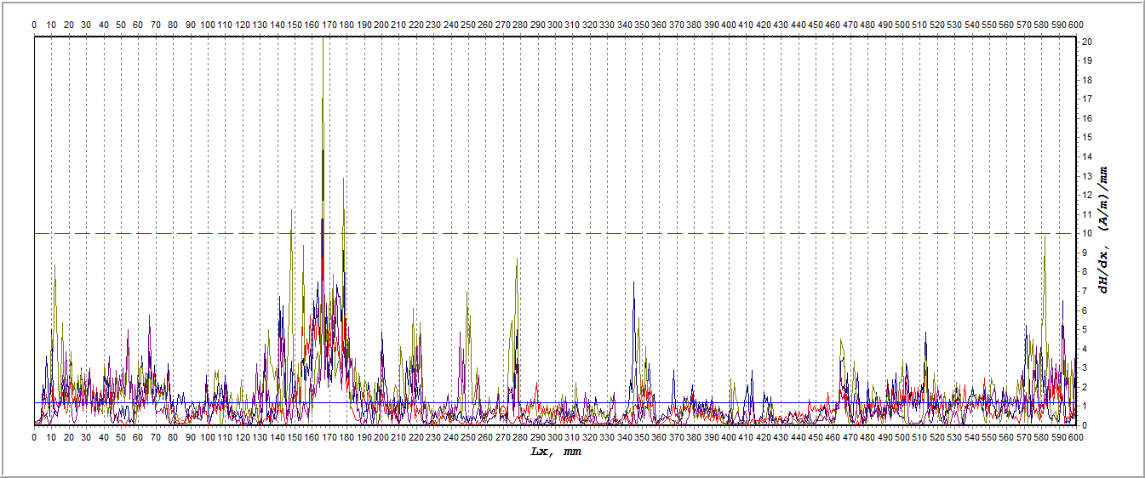
INITIAL POINT WITHOUT UPS TREATMENT

Slide 8
1ST UPS TREATMENT

Slide 9
4TH UPS TREATMENT

Slide 10
CONCLUSION
From the field trial it, it be conclude that:
MMM technology capable in detecting stress occur on the pipe spool
Ultrasonic peening solution capable to reduce the maximum stress occur in selected location
Reduction of stress value is significant with removal of external strain and coating removal.

Slide 11
Provides various solutions of asset integrity assessment
utilising the capability of latest NDE technology and current inspection approach in obtaining the data gathering for integrity assessment purposes.

